Slide 1
Applying the four operations to algebraic fractions
Maths 10A

Slide 2

Learning Intentions
Students will be able to:
Add and subtract algebraic fractions with a numerical denominator
Multiply and Divide algebraic fractions with a numerical denominator
WICOR

Slide 4
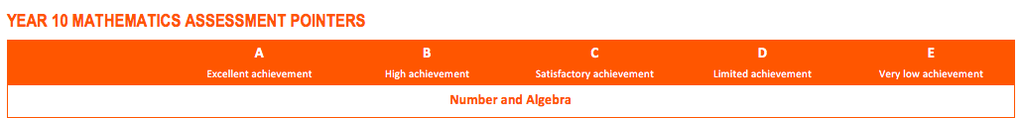
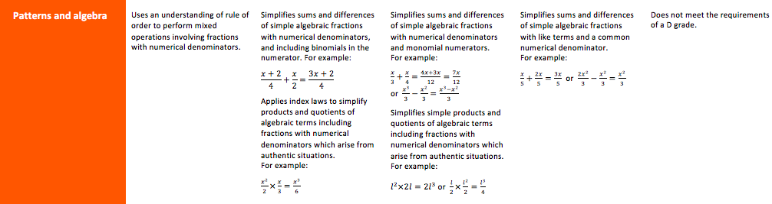
Learning Intentions
WICOR

Slide 5
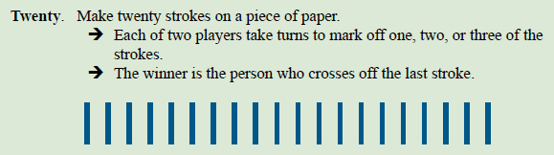
But first, a game
Notice any patterns?

Slide 6
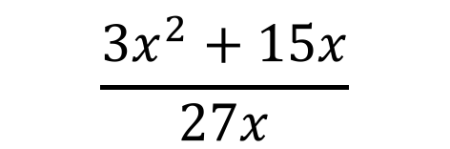
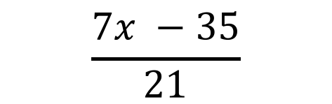

Think-Pair-Share
With a partner, discuss and figure out how you might factorise these fractions.
$$\frac{7x −35}{21}$$
$$\frac{3x^{2}+15x}{27x}$$
$$\frac{6x^{2}y+18xy}{21xy}$$

Slide 7
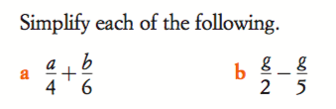
24
7
30
Algebraic Fractions
Date
EQ – What are algebraic fractions and how can we solve them using the four basic mathematical operations?
What are
they?
Algebraic fractions are fractions that involve algebraic expressions, rather than only numbers. The algebraic part may be in the numerator or denominator. They are added, subtracted, multiplied and divided in the same way as ordinary fractions
Adding
and
Subtracting
Just as with numerical fractions, the denominators must be the same before you can add or subtract fractions. You are looking for the lowest common denominator (LCD)
Ex:

Slide 8

24
7
30
Algebraic Fractions
Date
EQ – What are algebraic fractions and how can we solve them using the four basic mathematical operations?

Slide 9
24
7
30
Algebraic Fractions
Date
EQ – What are algebraic fractions and how can we solve them using the four basic mathematical operations?

Slide 10


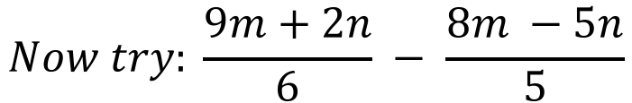
24
7
30
Algebraic Fractions
Date
EQ – What are algebraic fractions and how can we solve them using the four basic mathematical operations?
$$Now try: \frac{9m+2n}{6} − \frac{8m −5n}{5}$$

Slide 11

Do you understand? Fists of Five
Notes:
Check for Understanding

Slide 12


Slide 13



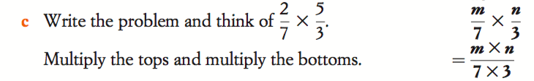
24
7
30
Algebraic Fractions
Date
EQ – What are algebraic fractions and how can we solve them using the four basic mathematical operations?
Multiplying
and
Dividing

Slide 14
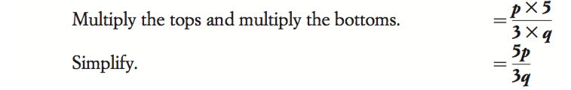
24
7
30
Algebraic Fractions
Date
EQ – What are algebraic fractions and how can we solve them using the four basic mathematical operations?
The crucial
step

Slide 15


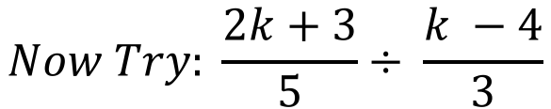
24
7
30
Algebraic Fractions
Date
EQ – What are algebraic fractions and how can we solve them using the four basic mathematical operations?
FOIL Method!
$$Now Try: \frac{2k+3}{5}÷ \frac{k −4}{3}$$

Slide 16
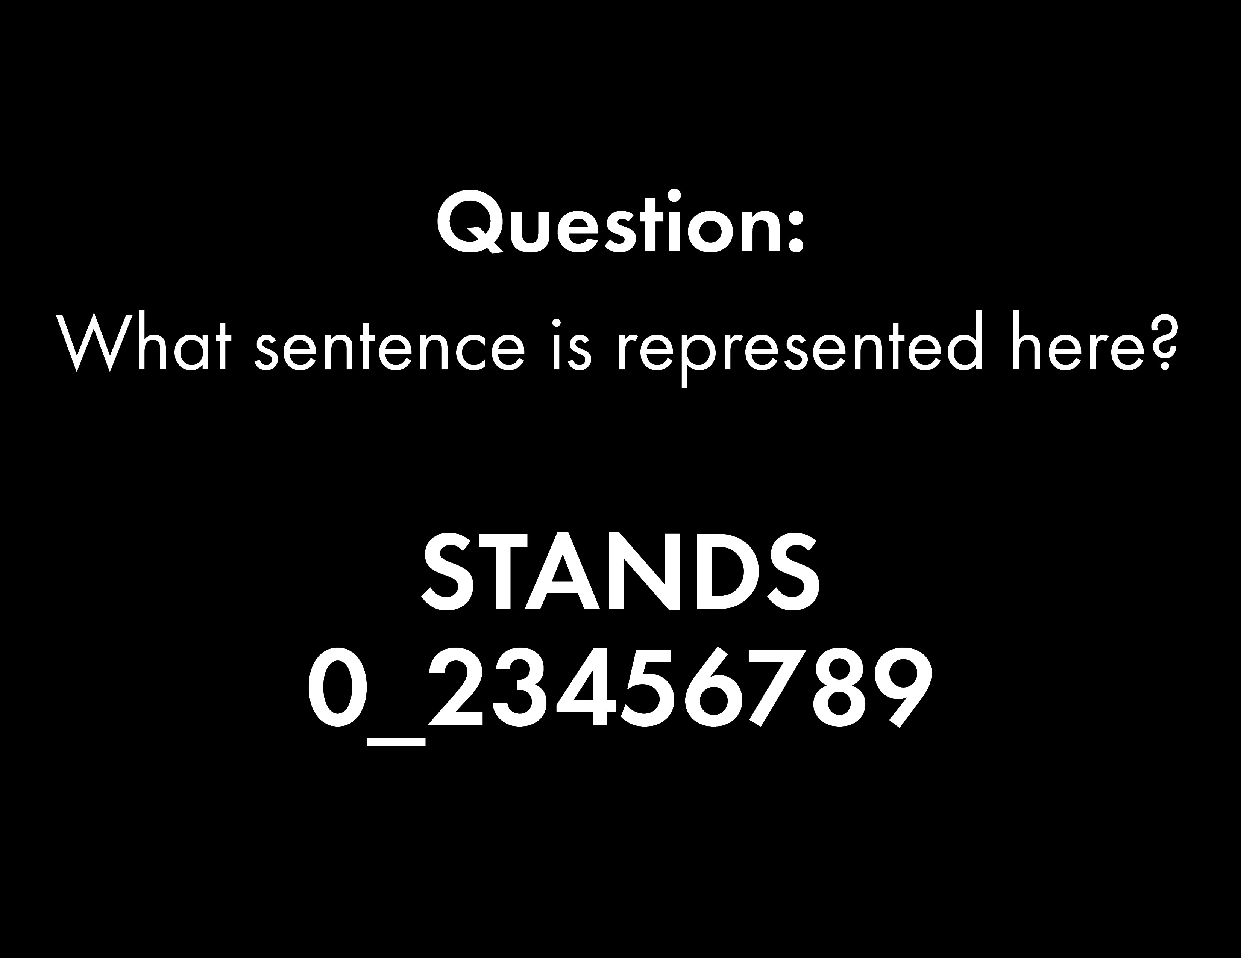

Slide 17
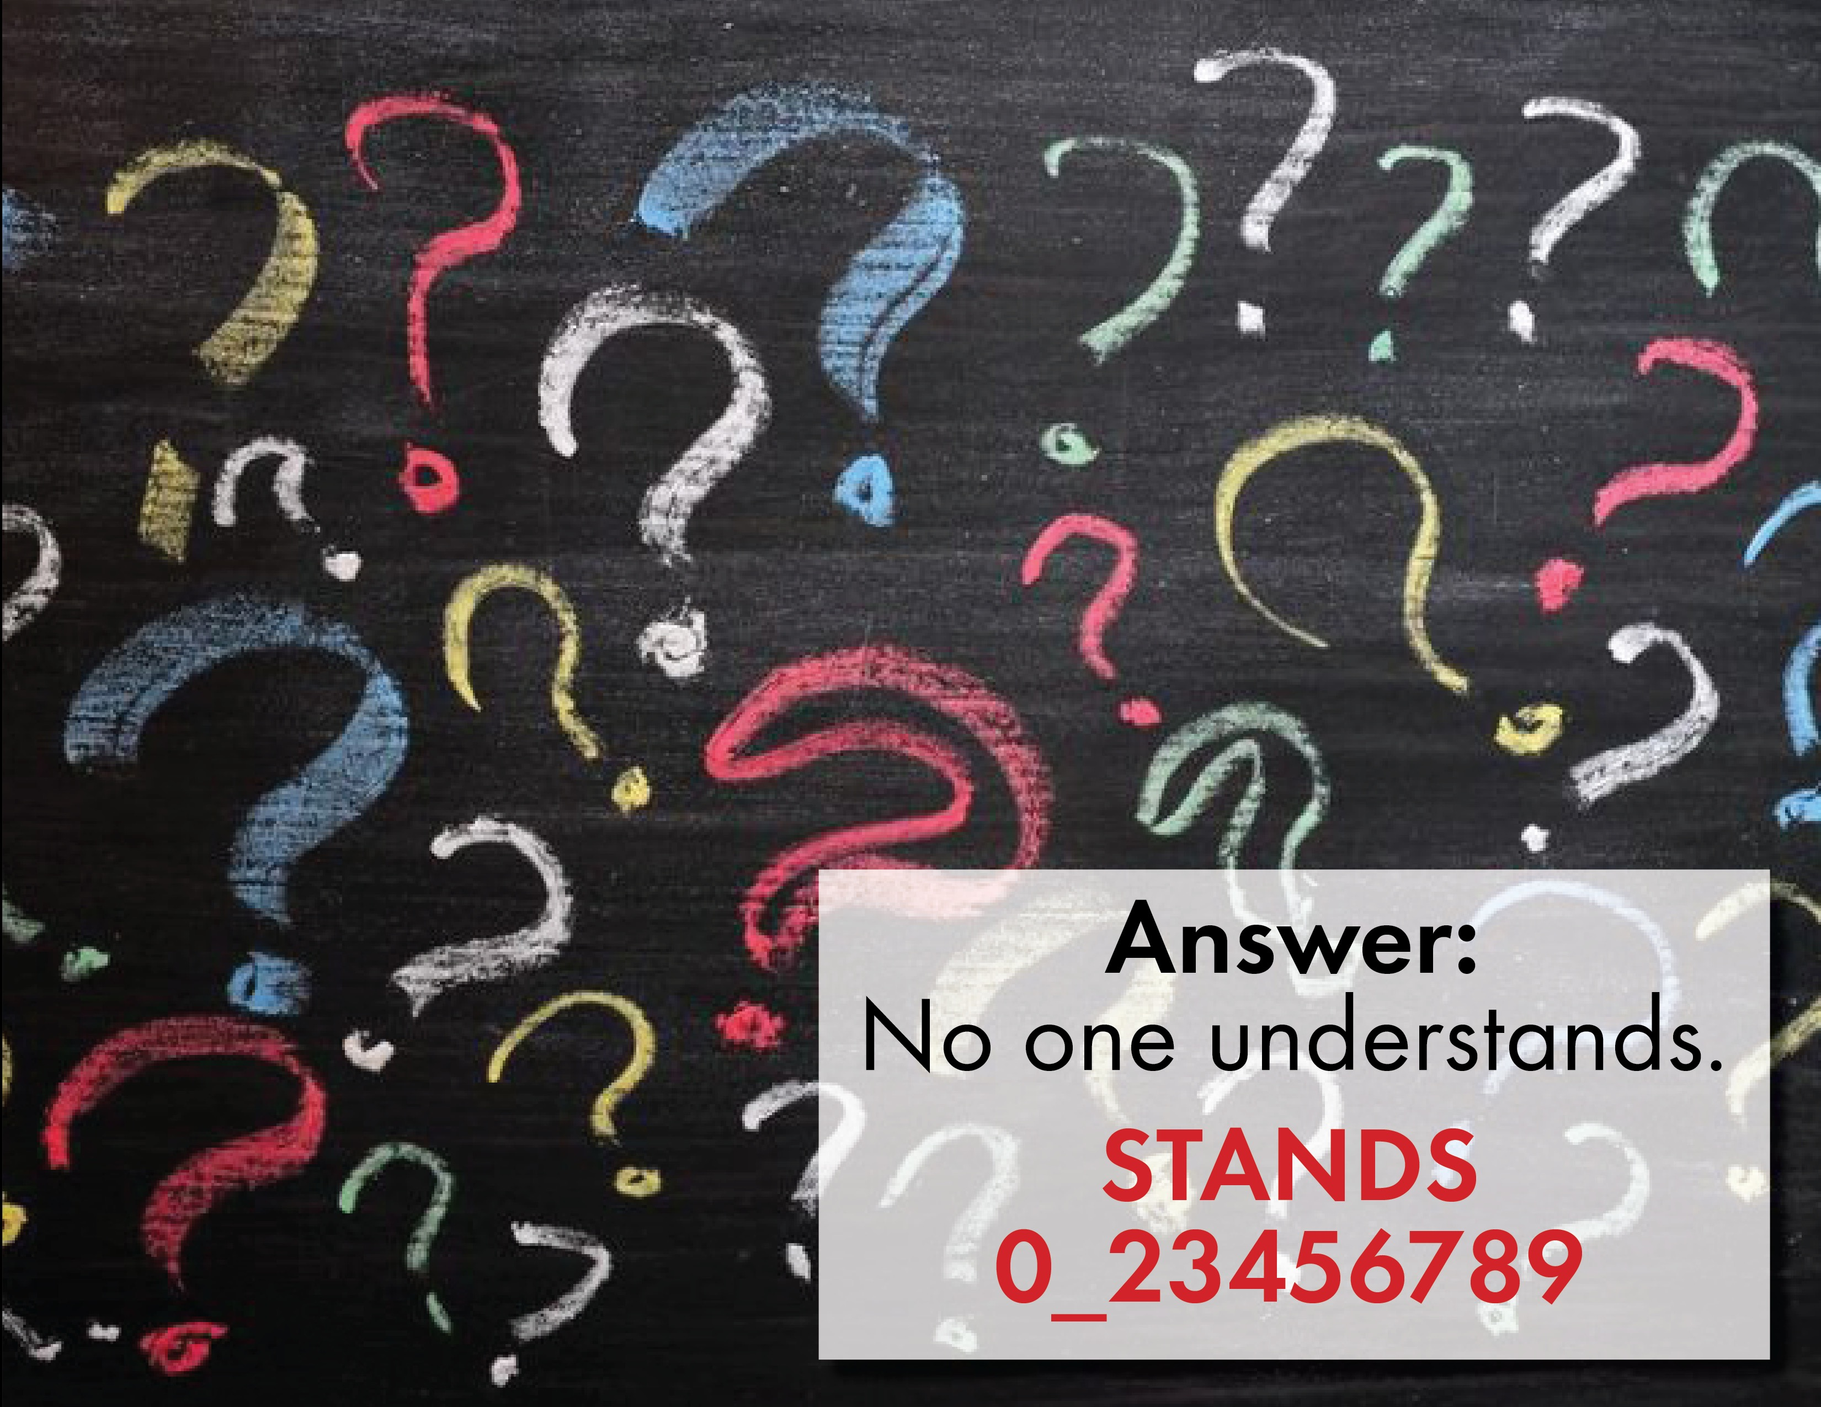

Slide 18

Does no one?
Show of thumbs

Slide 19
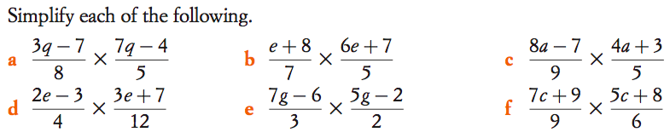
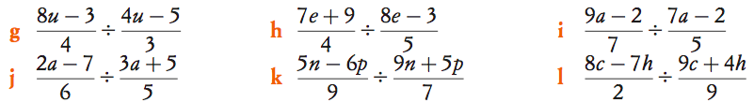

Slide 20

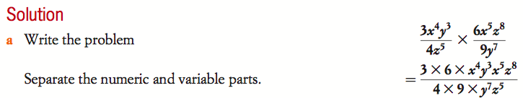
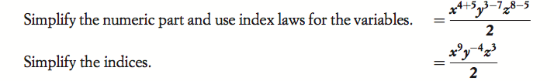
24
7
30
Algebraic Fractions
Date
EQ – What are algebraic fractions and how can we solve them using the four basic mathematical operations?
What happens when
the algebraic part
is in the denominator?
Now you try b)

Slide 21
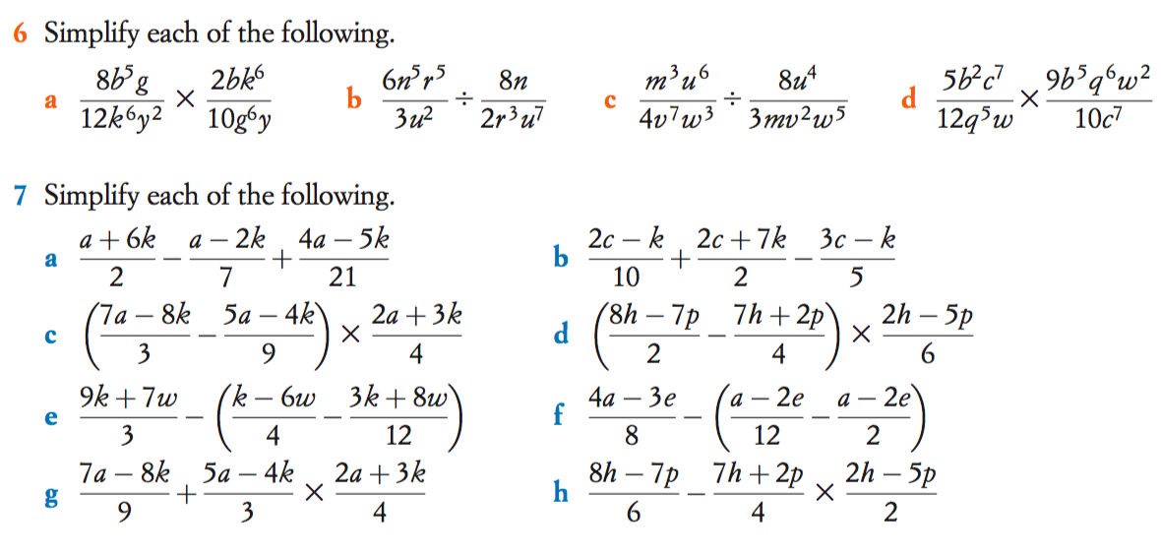

Slide 22
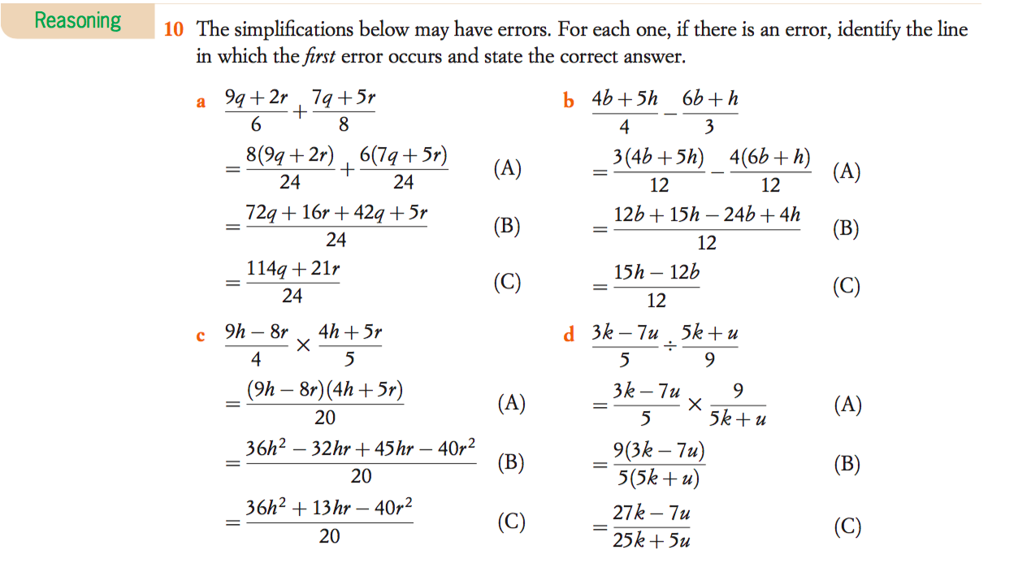
Exit Slip

Slide 23
Nelson Worksheet – Algebraic Fractions

